Slide 1
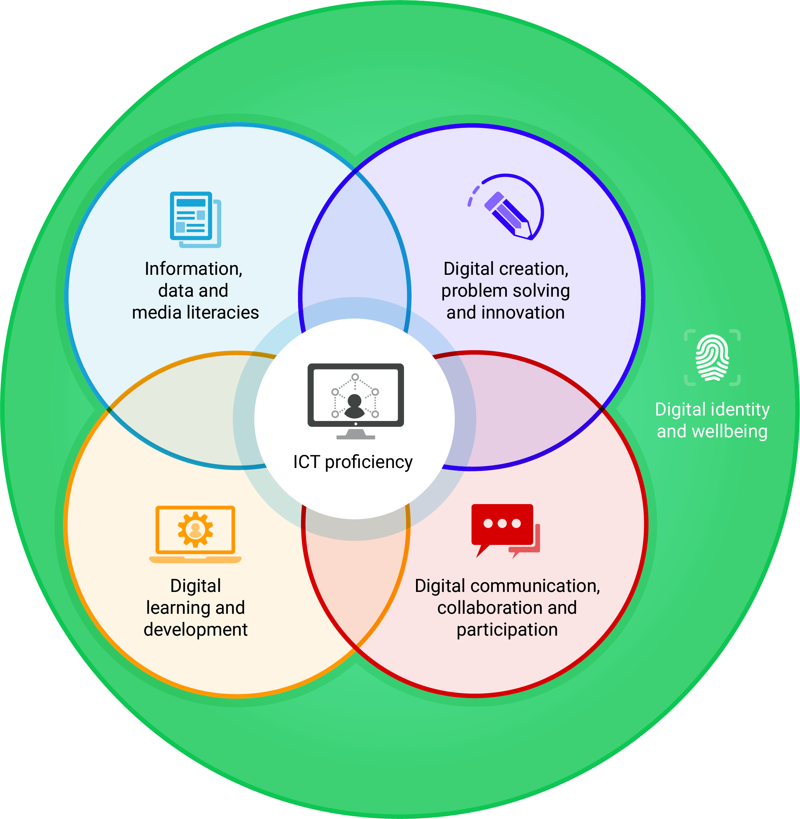
Talking about the Jisc digital capability framework – Part 2
With Helen Beetham and Shri Footring
Notes:
Shri: I’m here with Helen Beetham, the original architect of the Jisc digital capabilities framework.
In this presentation we’re going to be looking at the background to this framework, how it came about and some of the research that fed into it.

Slide 2
How the framework came about – early projects
Notes:
Shri: Helen, can you tell me a little bit more about where it came from?
Helen: Well, to do that I am going to have to go back more than a decade, in fact, to a project that Jisc funded back in about 2008.
They’d been persuaded that they needed to do some piece of scoping work on digital literacy.
It wasn't obviously part of what Jisc did back then. Jisc was about joining up systems and putting resources into place, it wasn't really about what people then did with them.
But as technology was becoming more and more diverse, coming into the hands of learners and teachers themselves, was kind of personal as much as organisational, then we did need to think about how learners develop the capacity with the digital that isn't quite a single system or single resource that sort of much for lifelong, more across the whole course study that is in some ways foundational of other capabilities in the way that let’s say literacy or numeracy are.

Slide 3
How the framework came about – learning literacies
‘Literacy’ implies:
A foundational knowledge or practice
An entitlement
Socially and culturally situated
An aspect of identity
Continuously developed, multiply expressed
Notes:
Helen: The project was called learning literacies in a digital age. It was project I did with Alison Littlejohn and Lou McGill and I think literacy was quite controversial title for it.
What we meant by that and what we wanted to do was to focus on was something that was much more foundational that just technical skills with particular systems. Something that would have an impact on students throughout their lives, something that was beginning back then to be thought of as an entitlement or a democratic right in the way that say literacy and numeracy are.
When we thought about it in further and higher education we really wanted to think about how it was situated in particular subject areas or disciplines and professions and we were aware that it was becoming an aspect of how students thought about themselves. How they use technology was part of their identity as learners and it was something they didn't just learn once you know when they arrived they had it fixed, it was something that evolved and developed through their time as learners, throughout their lives which really so it was something very multiple and complex and will be continuously expressed.

Slide 4
How the framework came about – digital capabilities
“ those capabilities that enable an individual to live, learn and work in a digital society ”
Notes:
Shri: Where did the idea of learning literacies or digital literacies come from?
Helen: Well it was certainly around at the time. There was a really popular and useful book published by Lankshear and Knobel that was widely used. Certainly people like Kahn and Kellner had been talking about multiple critical techno-literacies in the literature and we were picking up on those pieces work that had already been done.
There was also a concern in the learning and development community or academic practice community about how students’ habits of learning were changing and I think it was about bringing those two things together. So we were interested to look at both how student habits of learning were changing with digital and these much broader capabilities that they might be needing when they left education that would help them to find a job that was satisfying and you know participate in other ways.
Shri: I see, and that quote there that looks very familiar. Was the project the first to come up with that definition?
Helen: We certainly came up with that definition of what we were talking about or something very like it. It's been through a few minor iterations since and I think maybe that quote, that definition is one of the things that survived that project and allowed Jisc to build further work on top of it.

Slide 5
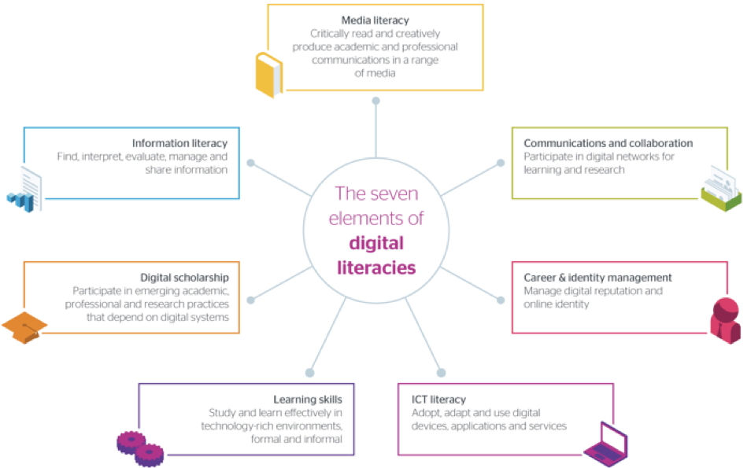
How the framework came about – an earlier version of the framework
Notes:
Shri: And I remember this diagram as well.
Helen: It still does some service doesn't it and funnily enough really this was drawn incredibly quickly towards the end of the work we did. It wasn't an outcome we were meant to come up with but we’d just been immersed so long in these various discussions about digital and learning literacy and I remember just quickly sketching out all the different spaces those discussions were taking place in.
There was quite a lot of contention around this there would be for people claiming different parts of the space. There were librarians with that kind of long-standing commitment information literacy, there were people in careers talking about the new employability and the 21st century skills, and there was an awareness that students were having to participate in new ways, and they take that through to their life beyond college and university. So it was deliberately very open unstructured because we didn't really want to impose on those conversations too much. We just wanted to know that they were taking place in this in these different spaces that there was multiple conversations about what digital literacy was and how students might need to develop it and the layout as I say was just collecting all that together as coherently as we could.

Slide 6
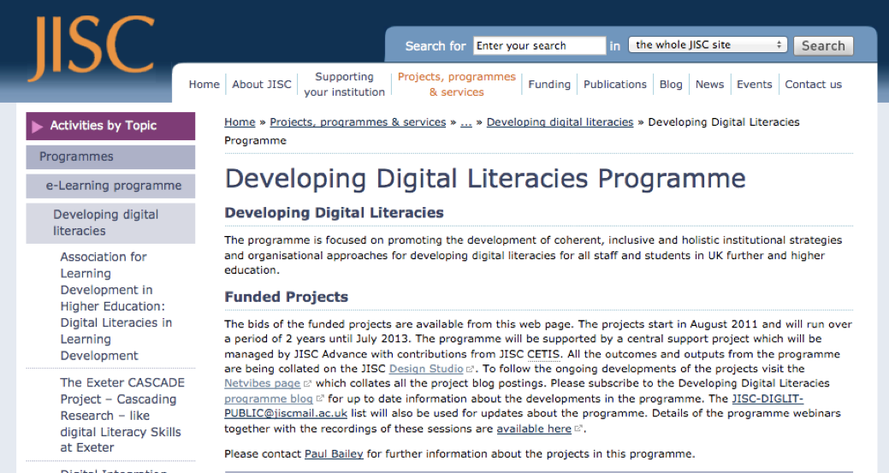
How the framework came about – Jisc funded programmes
Notes:
Shri: So how was the framework related to these larger funded programmes that I remember?
Helen: Well, not directly I suppose. So Jisc funded a range of project in the curriculum, and organizational projects as well you probably remember. And as part of the synthesis work that we did with those projects, who were all trying to embed digital literacy in a variety of ways and a variety of contexts and settings, as part of the synthesis work we did use the framework, we talked about it we got some really useful feedback on it and some of the projects used it very actively. So the project at Bath I remember worked with their faculties to come up with a version of the framework for each of their sort of broad subject areas and that still for me is one of there really nice uses of this kind of framework to encourage people to think in their own way about what these words mean what it means to be information literate if you're a lawyer or if you're studying the natural sciences. So different projects related to the framework differently and I think for me it was just really useful to hear the feedback from them about how they used it. When we did the final evaluation of all those projects one of the things that really came through was how useful it had been to have a variety of shared understandings of what it is we were doing, and the framework was one of those that people pointed to and said actually it was helpful to know we were talking about some of the same things. So there were useful conversations among all those very different projects but also within the funded organisations the framework had allowed some kinds of conversations to happen across spaces that didn't always talk to each other.

Slide 7
How the framework came about – a review of frameworks
Jisc 2015
Review of almost 100 frameworks and resources in use
Interviews with key organisations and stakeholders
Engagement with professional bodies
Outcomes:
Existing ‘7 elements’ well liked but not extensively embedded
Reflected current thinking (had influence)
Need for a clearer structure and progression
More input from stakeholders to support different versions/adaptations
Need for a variety of applications that made sense in practice
Notes:
Shri: So this brings us up to the more recent review in 2015.
Helen: That's right so I think it was very mainstream by then to be talking about digital literacy, to be assuming that it was a part of the landscape of institutions and curricular teams needed to think about it and Jisc really wanted something much more robust and consensual than we had from that earlier piece of work. So they asked me to look at some of the other frameworks and resources that were in use in the sector, and beyond the education sector as well. Lou McGill and I looked at think in the end it was almost 100 different resources and frameworks to really try to understand where they had come from, what the evidence was that supported their development, but also crucially how they were being used in practice because there was a plethora frameworks and there are even more today, but it was much harder to know which ones actually proved to be useful and actionable and why that might be. So the other thing that I did was interview a whole lot of key stakeholders in different organisations and professional bodies, going back to our insight that this is owned in lots of spaces in the institution if Jisc wanted to play in that space then it had to be very respectful of the work people were already doing and the ways in which digital capabilities were already part of lots of people's professional practice.
So, we had an engagement with individuals and with professional bodies and it was a complex piece of work and the outcome of that rather to my surprise was that the original seven elements was actually quite well liked and well recognised already. It hadn’t been extensively embedded or systematically used but people said - You know, this seems to cover a lot of the content that needs to be in there. And actually, if you look at the other frameworks being developed which will do in another presentation you can see that the content itself is extremely well reflected in those other frameworks is a real consensus emerging about the kind of thing were talking about when we're talking about digital capability. So, the framework already, the seven elements, reflected reasonably well the kind of current thinking that had been adopted a little bit but there was a need for much clearer structure, a sense of progression which just wasn't there in that very open space. How do you get to this aspirational place of being digitally literate, what's involved and how do you take people through who might be responsible for different parts of it. We needed that input from stakeholders to ensure that anything we came up with really was properly adapted and embedded and was actionable. And I think we also knew, from that review, and have had confirmed that a framework in and of itself is not very usable by a large number of people. It's really useable us people like us who want to use this language and who are to some except specialists, but if you want it to be adopted into practice more widely you have to come up with a whole range of ways that people can interact with it which aren’t the framework itself but might be other kinds of tools and resources that are based on it

Slide 8
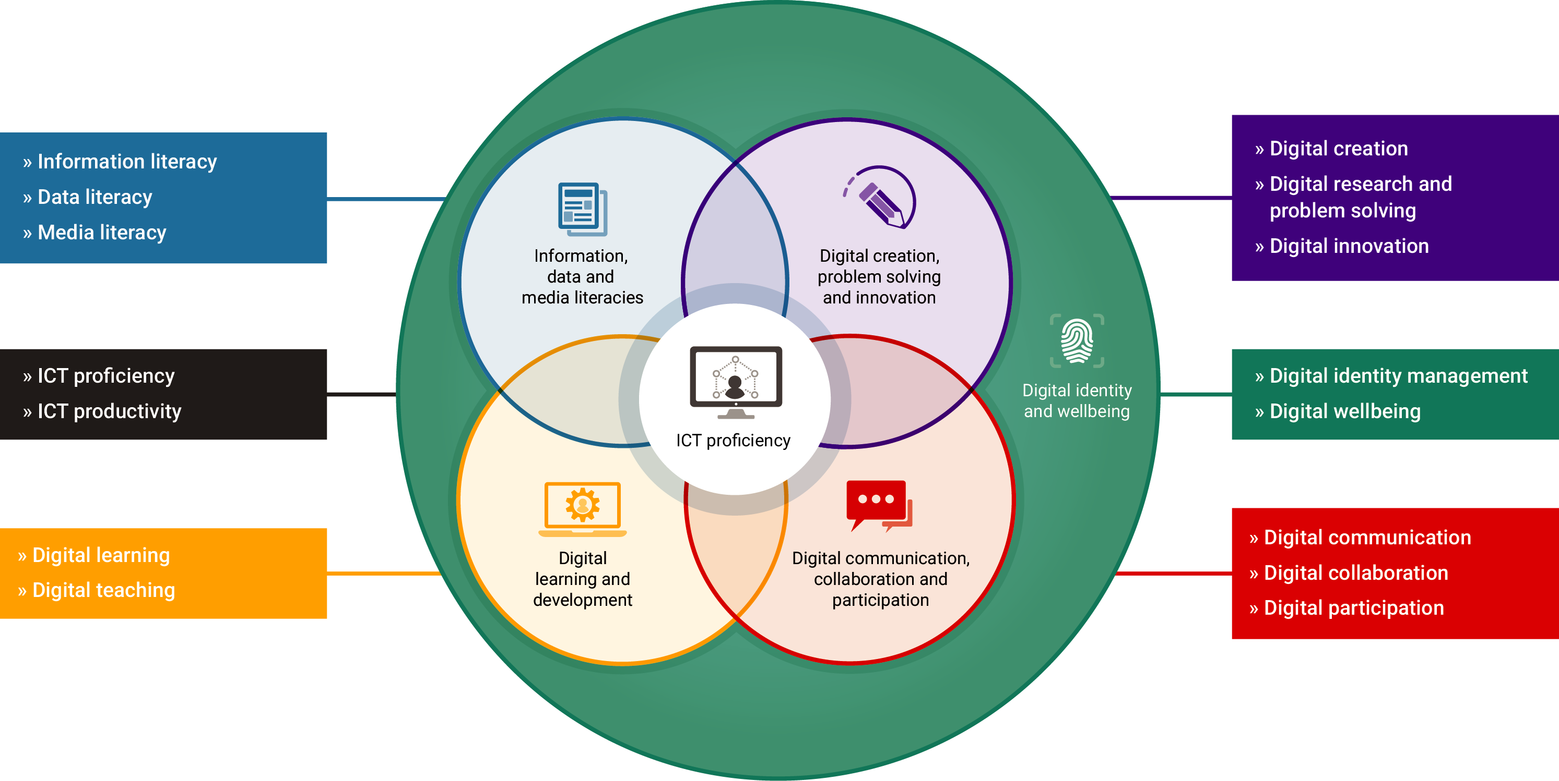
The Jisc digital capabilities framework
Notes:
Helen: So here we are with the digital capability framework. And we’ve got a couple of other presentations now that are going to talk about what's different about it and also just go into a bit more detail of the structure of it, the different elements of it, how they fit together and how it might be used to practice
Shri: This is really helpful, thank you Helen.

