Slide 1
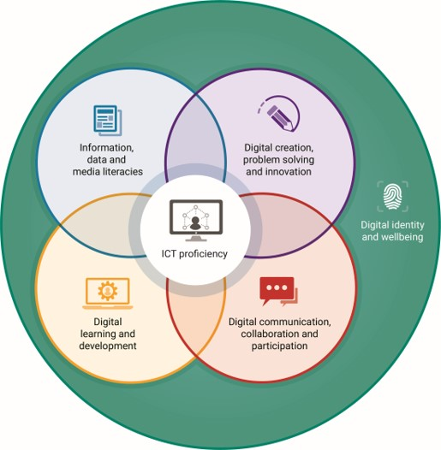

Talking about the Jisc digital capabilities framework – Part 4
With Helen Beetham and Shri Footring
Notes:
Shri: I'm here with Helen Beetham, the original architect of the Jisc digital capabilities framework. We've seen a little bit about how the framework evolved and has come about but I'm aware there are a lot of frameworks out there and I'm also aware that this one is very widely used in the UK HE and FE sector. Can you tell me something about why this framework has gained traction?
Helen: It's a really good question and I think Jisc might well have simply adopted an existing framework if there perhaps had been earned better established one back in 2009-10 when Jisc was first thinking about this issue but let's take a look at the sort of range that's out there and see how it started to converge in recent years

Slide 2
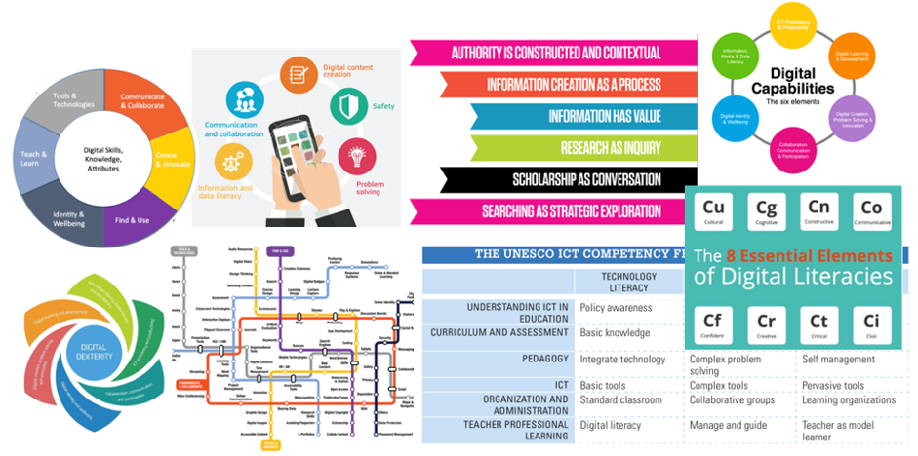
There are many examples of digital frameworks …
Notes:
Helen: So as you say Shri there’s many examples of digital frameworks out there. Some of them specific to different sectors of education, some of them to professional sectors, some of which are owned nationally and internationally. To begin with I think there was quite a lot of churn, but if you start look at what's happened in the last 5 or 6 years there's been real convergence on the issues that seem to appear in all of the frameworks and in quite similar words being used about them so

Slide 3
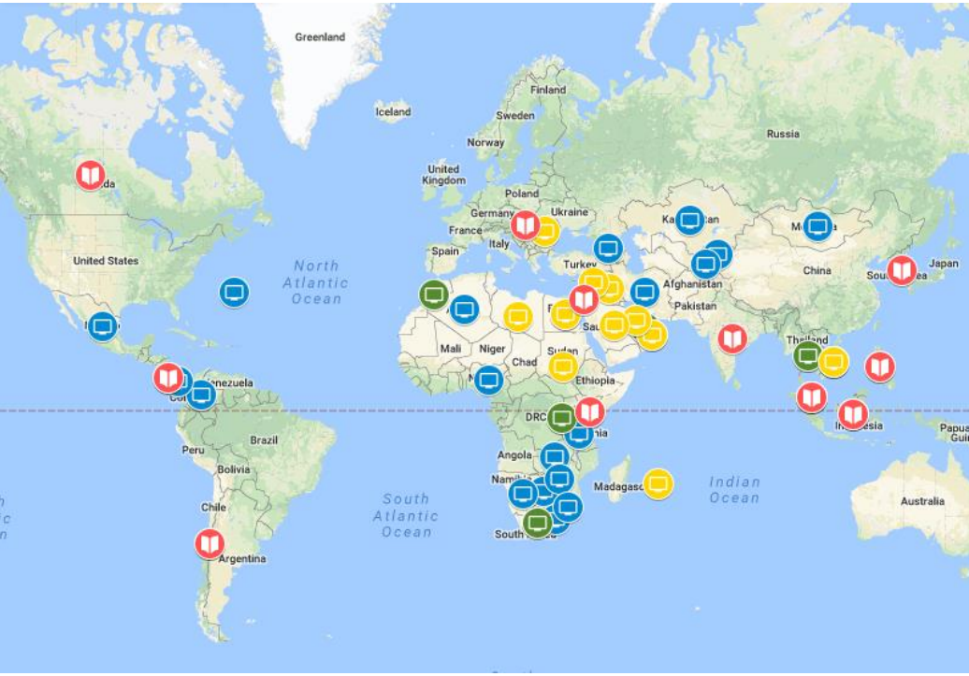
But there is considerable convergence
Devices and software operations
Information and data literacy
Communication and collaboration
Digital content creation
Safety
Problem-solving
Career-related competences
Notes:
Helen: So the OECD has done a very recent global review of different for different frameworks and benchmarks and come up with a series of issues that need to be addressed which you will recognise are very similar to the ones that Jisc has been using for the last best part of a decade. So, you know, the ones that focus more on the kind of functional skills for using devices, using software and so on.
The information and data literacy aspects communication, collaboration, and the creative side of thinking; and more about wellbeing and safety; and then the problem solving and employability aspect. So we can recognise those as being now internationally kind of part of the vocabulary of what this means definitely.

Slide 4
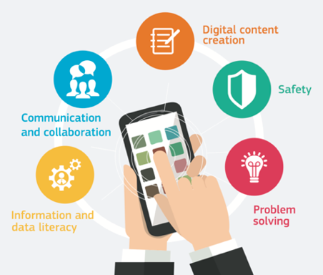
Example of convergence:
EU’s (2015-18)
DigComp and
DigEdu frameworks
Notes:
Shri: Definitely, Helen, thank you. I know you have had quite a lot to do with the development of the EU frameworks. Can you tell me a bit more about that?
Helen: Well, me and hundreds of other people. The great thing about this framework is that it has to be consensual among a whole lot of quite diverse cultures, diverse educational cultures and people have their own points of view about this so it's very much a consensual operation.
It's been in development for a number of years and again you can see that when you put all those people in the room together, or in many rooms together, over many years, the things that come up with are not too different from the things that Jisc has come up.
The framework for the EU is also interesting I think because like Jisc they have a very simple high-level expression of what they think is required and then they break that down in a whole number of much more accessible and actionable resources. There is actually a very detailed competence framework that can be mapped to a whole range of jobs and professions.
There are increasing numbers of resources available and courses that you can do for each of these different areas.
There is a framework for organisations, so you think about the organisational level responsibility as well as frameworks for students and staff. And there’s a diagnostic tool, you’ll be interested to know, which is been in development.
Shri: Yes, I’ve come across it!
Helen: Yes, so I think we can see not only that this converges on the kind of issues that need to be covered but is also convergent on the idea that the framework really is it is the mapping point, is the pivot for a whole lot of resources and tools that make these ideas actionable for individuals. Not everybody's going to engage with the words that are on the screen here but hopefully they'll be something they would engage with that will help them to develop and take them forward

Slide 5
Specific to the education sector
  Engagement with professional and sector bodies
  Focus on learning and development
  Scholarly flavour to definitions
Notes:
Shri: That's really interesting Helen, and you’ve said there is convergence. But what is it that Jisc has got right?
Helen: There are a couple of things that make this very usable, particularly in education.
So the first thing is it was always developed to be about and for this sector, that is education. It is designed for everyone who works for them in our sector and to address the specifics of digital learning and teaching and scholarship.
So it has learning and development as a capability on its own as the orange circle in the middle.
Of course learners are also citizens and future workers, and educators are also professionals, in a variety of ways, but our focus is on them as learners and educators so the practices that are needed by that, particularly in learning spaces in teaching spaces where knowledge becomes digitally mediated when learning becomes digitally enabled.
So that's partly thanks to the engagement that we had with professional sector bodies that helped to shape this framework and I think that also explains why some of the definitions when you dig down have quite a scholarly flavour to them.
So for example when it comes to section about problem solving, we do talk about scholarship, talk about research, which might be less relevant for other sectors. But in our sector were always thinking out how it is that we solve problems as learners as scholars. As people who are trying to deepen our understanding of the world.

Slide 6
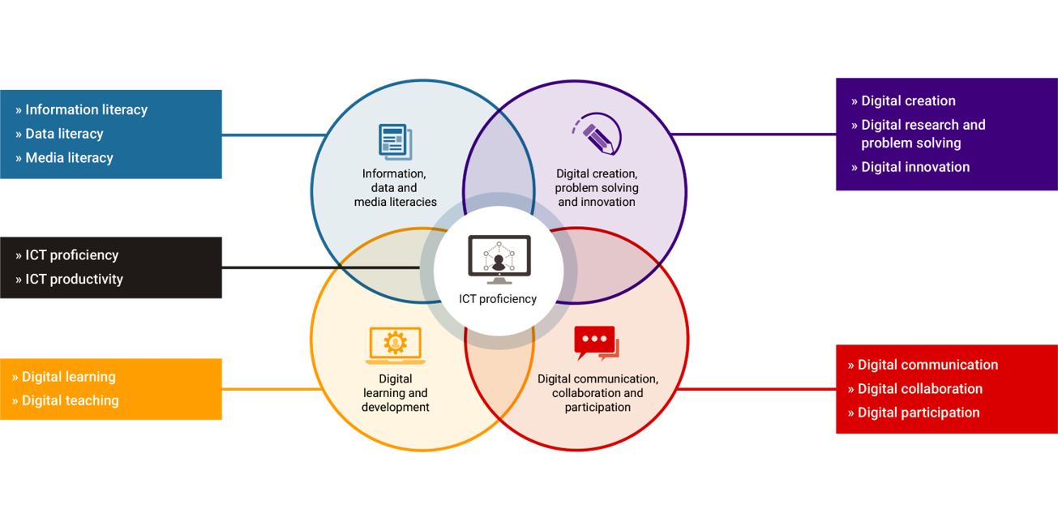
Focus on key practices in the education sector
Notes:
Shri: That certainly is the case. In my experience over the last couple of years I would say that many people are using this framework in universities and colleges.
Helen: Well, that’s good to hear.
When you look at the centre to framework and the kind of key practices that are there, you can see that we do have that focus on learning the orange circle down in the corner.
We have that focus on problem solving and innovation in it in a kind of scholarly way but also in the education sector we are really concerned about information data and media literacy. It's probably worth saying that data got added after the first Seven elements model in 2010. We had the information and media literacy, we were very interested in how students were acquiring information, and becoming more critical of information, learning to read with less using digital media.
I think data literacy back in 2010, it's hard to remember, this seemed like a very minority interest. There were some subjects you would study which would take a very intense interest in data and how that was being digitised, possibly in databases. But now it’s difficult to imagine it any kind of learning, well not just post compulsory, any kind that doesn’t involve understanding about what you can do with data, what data can do with you. You know I think it fits very centrally into what we think we're about in education.
And then participation. I mean clearly participation in digital networks of various kinds is an aspect of citizenship but when you're thinking about learning or when you're thinking about being an educator or being a researcher, you're thinking about particular kinds of participation networks, how you build criteria for judgment collectively with other people, how you share ideas.
So all of these key practices have a particular flavour that I think comes from being based in the education sector and I think that may be one reason that this framework has shown itself to be quite readily adaptable.

Slide 7
Wellbeing is an important element
Specific to the education sector
  Engagement with professional and sector bodies
  Focus on learning and development
  Scholarly flavour to definitions
Wellbeing
  Care for the whole person
  Responsible for safe, ethical behaviour
Notes:
Shri: That's useful. Also, wellbeing is an aspect that's been increasingly picked up and has growing importance this area.
Helen: You know that outer circle was actually very difficult thing. We went through lots of iterations and different people had different views about it within the project.
So originally, that was digital identity on its own and I wanted to bring in the idea of citizenship. Other people wanted employability.
And in the end this term ‘digital wellbeing’ came to me, as a really interesting one. I hadn't heard those two terms being put together in quite that way before.
But I think digital well being does tie in specifically to the education sector, and our responsibility to help people to thrive, to do well overall, to care for them as they are learning and developing. It moved the idea of identity, for me, away from something that you're managing very carefully in a particular space towards something more authentic. Like how am I able to be in a digital space, how can I realise my own purposes in life, my own aspirations, how am I going to thrive on my own terms supported by these digital practices that I'm developing.
So essentially the digital wellbeing is part of the framework that actually seemed the most risky because it seemed the most new and controversial in 2015 is actually been one that has really taken off. Lots of people are developing resource is around it, universities and colleges have really moved into this space with things like safer Internet weeks also I think yeah that support was the development that really seems to have picked up on that. Part of the Zeitgeist if you like

Slide 8
Capability: subject neutrality, social responsibility, context
Specific to the education sector
  Engagement with professional and sector bodies
  Focus on learning and development
  Scholarly flavour to definitions
Wellbeing
  Care for the whole person
  Responsible for safe, ethical behaviour
Capability' implies:
  Subject neutrality
  Social (not just personal) responsibility
  Importance of context
Notes:
Shri: I’m really keen to get to grips with why you used the term ‘capability’ rather than ‘literacy’ as it originally was.
Helen: Gosh well do you know a lot of this is really quite strategic and I'm not in favour of pursuing academic definitions so the Nth degree so much as I'm in favour of finding terms that actually make things happen.
There were problems with literacy as a term. It resonated really well with some parts of the education sector particularly some subject areas. It resonated really badly with teachers of natural science and with some people who felt literacy was something that happened much earlier in the educational process than we normally get involved.
It was associated with certain theoretical schools as well, which make quite strong claims venting certain things and not other things, so it had become a little bit of a problem that had to be overcome every time the framework appeared.
However it was a bigger problem to know what to replace it with. I was very resistant to replacing it with anything like skills or competences, even though these are very well recognised terms. When appropriately used, they are absolutely right, because I thought we'd moved to talking about things that were much broader in scope and were much more about situated practices of the digital rather than kind of composite skills.
And the reason I like capability, and luckily Jisc liked it too which was a relief, for me it's associated with the work of people like Martha Nussbaum and Amartya Sen, who talk about capability as the ability to thrive. For them its not just about personal quality I think that I have but it comes from being in the right setting with the right cultural resources, having the right people around me to allow me to you behave in those ways.
And the same with learning you know we see learning as a kind of this individual outcome of study and hard work and opportunity, but at the same time it was the product of a supportive context. And our organisations are responsible for providing that context. It's not OK to pretend that this is something that individuals just have to do on their own.
So whether or not people know that there’s that kind of philosophical movement behind it, I felt capability was a kind of a term that would gain ground and luckily it seemed to hit the rising ground and people liked it and it worked.
And by 2015, when were starting to think about the whole space, it was really clear that creating identity in the digital space, engaging in the digital space and engaging digital practice had risks as well as opportunities and so we need to think about the whole person. Need to think about what we said about wellbeing as well as kind of functional skills, how we pursue our aspirations as whole people in the digital space and I think to bring into that discussion the ways we might not achieve what we wanted to and how the digital might actually produce new kinds of risk and new kinds of inequality as well. So it was a strategic decision to do with making the framework actionable and accessible but I think you know is allowed us to have other conversations that I welcome.

