Slide 1
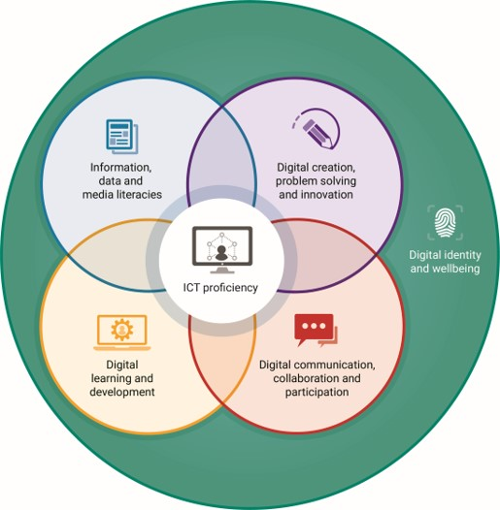

Talking about the Jisc digital capabilities framework – Part 5
With Helen Beetham and Shri Footring
Notes:
Shri: I’m here with Helen Beetham, the original architect of the Jisc digital capabilities framework. In this section I am really interested in how the framework was is put together.

Slide 2
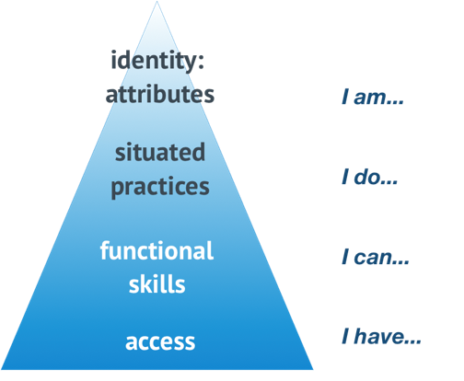
Digital literacy development pyramid
Digital literacy development pyramid
Beetham and Sharpe 2010
inspired by Maslow’s hierarchy of
developmental needs (1943)
Notes:
Helen: Thanks Shri. So, to explain the structure of the framework I need to go backwards a little bit before going forwards and think about another earlier piece of work that I did with Rhona Sharpe and a number of other people, again funded by Jisc, where we were investigating learners experiences of E learning. In particular we were trying to get beyond thinking about functional skills to talk about how digital technologies needed to be really meaningfully embedded into the curriculum. Embedded into kind of meaningful tasks that the students had actually signed up for and would engage with.
We devised this version of Maslow's hierarchy of needs that there's a lot of people will know from basically to training or professional development work and at the bottom you've got basic access. Basic access to digital resources and networks and devices. Built immediately on top of that others were functional skills to engage with the axis that you've got to make it useful. But on top of that, we wanted to start thinking out the situation practices of different subject areas of professional roles where the digital skills you've got can be used can be deployed in a variety of ways to achieve a meaningful outcome something that's meaningful in that setting. And finally at the Top of the pyramid, like Maslow, we had self actualisation although we made that little bit more accessible and we called it identity or identity attributes and I suspect already you can begin to see a few connections with the development model that we have today

Slide 3
Digital literacy development pyramid – curriculum context
Layer 4 (top): Extensive, open ended tasks
Layer 3: Developing repertoire
Layer 2: Intensive scaffolded tasks
Layer 1 (base): Access
Notes:
Helen: And having made the connection to Maslow we were able to really think about what this looked like in the curriculum, drawing on existing educational pedagogical know how.
So we could think about how functional skills might be built through intensive scaffolding tasks that might take place up quite early in a study career. They might be supported by various kinds of professionals, librarians might be involved there, learning support staff might be involved.
As students go through a course of study or a career in a college or university they become progressively more extensive and open ended and authentic and realistic tasks to challenge them. And here they become a variety of the skills they and develop sort of repertoires of using different forms of digital access, different kinds of tools, different kinds of techniques and applying them as spares required by the situation.
So we wanted to include these ideas of the situated practices and the broader, more extensive kind of digital skills without just creating that as an aspiration not showing how they could actually be embedded in different ways in different subject areas

Slide 4
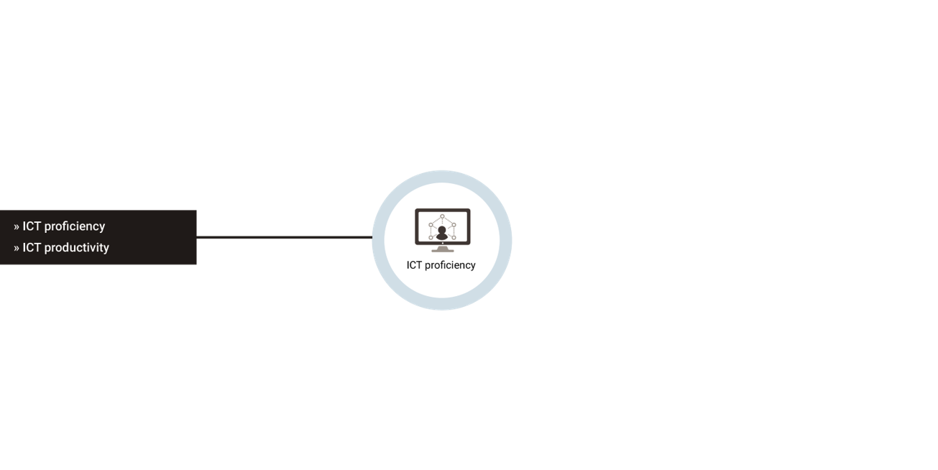
Elements of the framework – the inner layer, ICT proficiency
Notes:
Helen: So if we go back to the actual framework you can see that the development pyramid is there in the framework it slightly inside out at the bottom layer of the framework, being access and functional skills, is there right in the middle of the digital capability model.
It's the proficiency it’s the productivity, it’s functional skills with ICT that are at the base of everything else.
They might relate to a specific technology or technique and of course the bigger your repertoire of technical skills that easier you're going to find it to adopt new ones, see more situated practices you're going to be able to participate in, the better you're going to be able to judge the tools and skills that you're offered.
So although its technical there's also a kind of mindset involved here, it’s the capacity to adopt new models ideas tools techniques and they come forward to feel confident that you can integrate them into existing practice

Slide 5
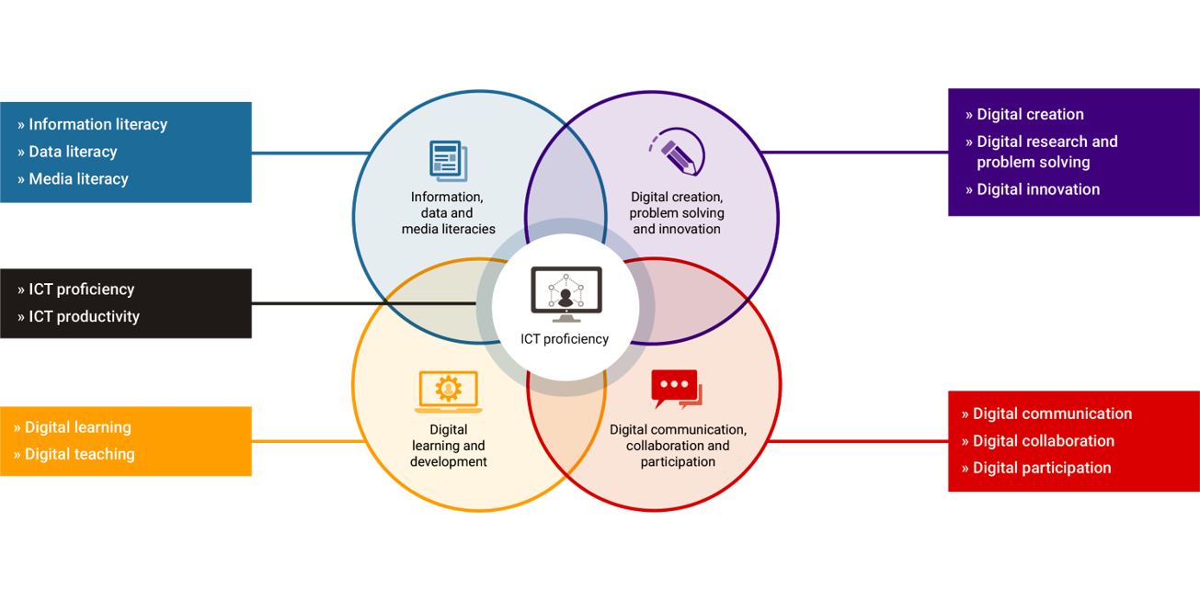
Elements of the framework – the middle layer
Notes:
Helen: So this middle layer of the framework then is the real meat of it.
What we called situated practices or ways of thinking, ways of doing with technology in our pyramid and when I'm working with the framework in the curriculum setting I really focus on these 4 areas and I would call them ways of thinking ways of doing.
They can really only be developed I think in relation to meaningful questions or challenges and perhaps only in specific contexts. The context gives the meaning to the practice and it also gives access to the resource is in the context so in learning would be thinking about access to more knowledgeable other people who want your tutor who might be an expert of some kind. We’ll be thinking that there will be maybe some special methods to learn and some rules about how to apply them, and there’ll be established resources of knowledge and know how around to help you do it

Slide 6
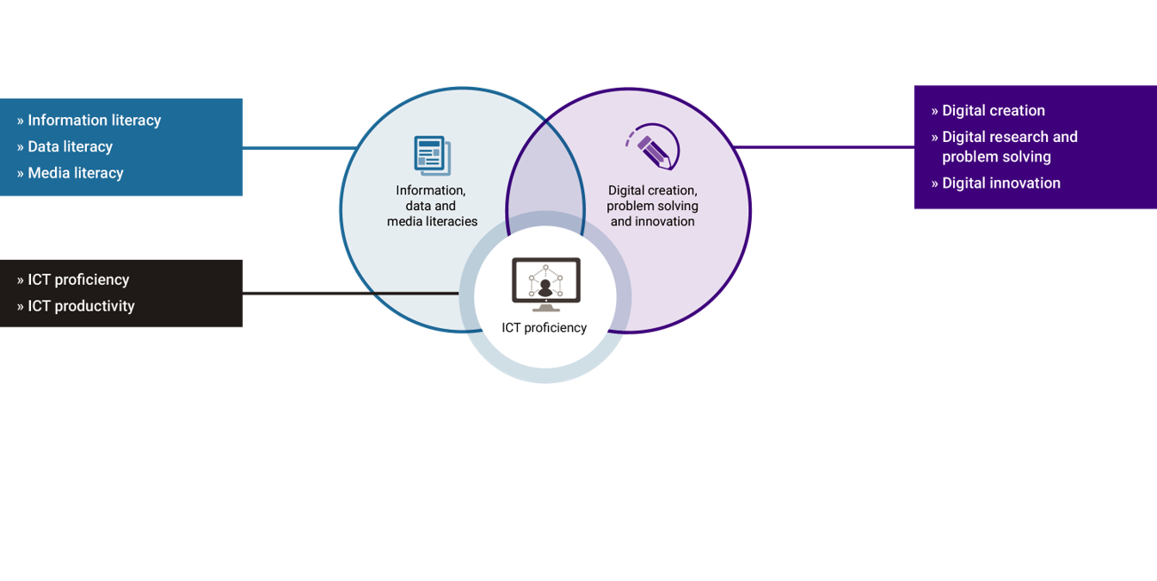
Elements of the framework – upper middle layer, specialist practice
Notes:
Helen: So two of these areas of situated practice I would say tend to be quite specialised and they are information data and media literacies and digital creation problem solving research and innovation
And when you think about these you’re probably thinking about practices that are really specific to a subject area if you're a student or professional role. This is where the framework really needs translation for the different contexts in which is it is put in to play.
So solving problems doesn't really tell you much unless you say what sort of problems? what kind of methods are available? how is the digital changing those methods? how is the digital creating new challenges and problems?
What kinds of solutions? how will learners or specialists present those solutions? Will it be through visualizations? Will it be through video? Will it be some kind of coding or whatever. When you think about information data and media literacies similarly they clearly have some kind of ownership in parts of the institution like in learning resource is or in the library but at the same time when you think about setting tasks for students to do, you are always thinking about the subject area and making this task meaningful.

Slide 7
Elements of the framework – lower middle layer, generic practice
Notes:
Helen: Then these other two areas of the central circle, participation engagement and learning and development, are perhaps a bit more generic.
As a student I guess you might be developing these things through co-curricular activities as well as through your studies and as a professional they would be quite transferable across different roles.
So we might think about learning practices such as curation, reference management, mode making managing time and tasks, that kind of thing or we might be thinking about professional practices such as collaborating effectively online. These are all changing really profoundly as we have access to digital tools but you can't reduce them to the tools themselves or the technical skills or anything simple and functional. You can't say they learned once and for all – these are things that you develop over time and across different tasks and settings and we make choices about how we do these things that eventually become features of our personal style

Slide 8

Elements of the framework – the outer layer
Notes:
Helen: And then finally we come to this outer layer of the framework. The top of the pyramid, the one we called identity or self actualisation in the pyramid and here we’re calling identity and wellbeing.
And this is about what kind of learner, what kind of scholar, what kind of practitioner or professional are you aspiring to become? How are you going to use all your digital resources and skills and capabilities and all your experience of practice to achieve what you want and to be who you want?
And of course the study this might be kind of capstone activity or a creative project or perhaps a graduate attribute. And in professional life it might be a professional standard.
Wanting to achieve these things at the top of the model or the outside of the model is what motivates us to develop some of those things further in. So we can see that there's a flow in both directions. Motivation flows in from the identity layer towards the component skills and scaffolding a progression flow out up from the baseline
Shri: Thank you Helen

Slide 9
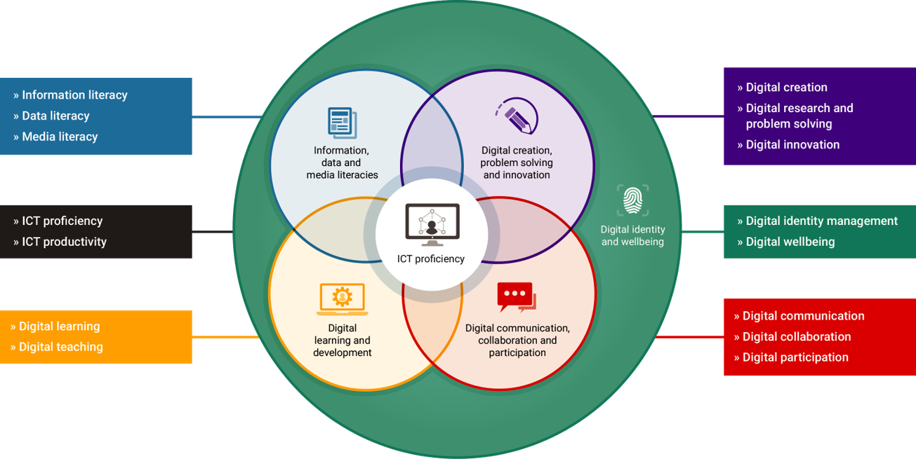
Fifteen sub elements of the Jisc digital capability framework
Notes:
No audio. This is a reminder the full framework showing the six elements as well as the fifteen sub-elements discussed.

